Slide 1
College Management System
Vikas Chavan (En.no:-EBENO322572159)
Poojith sai Geesala (En.no:-EBEON0322579270)
Anjal I Devati (En.no:-EBEON0322581246)
E. Tamil Selvan (En.no:-EBEON0322580628)
Jahnavi (En.no:-EBENO322572159)
Guided By
Varadharajan A

Slide 2

College Management System
list of Entire Modules
01
Main page module
02
Login & Registration page module
03
Chatbot module
04
Admin module
05
Library module
06
Student module

Slide 3
My
Modules
Main page Module
Login & Registration page Module
Chatbot page Module

Slide 4
Main page module
Html
CSS
I used HTML to create a Structure od main page the main page contains logo, heading, icon references and hyperlinks to other pages.
The CSS is used in the style tags within the .html files in CSS We used animation delays Font colours, moving objects, layer, and specific timing delays to pre plan the events of every moving objects on the main page
Hyperlink tags
chatbot
The hyperlink tags from the html page opens other pages like about us page, contact us page, our services, my team and their work and login & registration page.
The chatbot is working with pre defined inputs and outputs with the help of java script if-else condition i.e. based on given input the if else condition works

Slide 5
Main page module
Our Services
About us page
Our web project gives many services like: digital attendance , E-Library, 24/7 Doubts clarification, Online Course enrolment, online study materials and Scheduling of classes
The about us page provides the info about our project and the technologies used in the project.
Main page
My Team and their work
Login/register page
This page provides the particular information about every individual who are in the project and their efforts and works contributed to the project.
The login and registration module is done with spring framework and thymleaf for frontend & backend connection with MySQL database connection.
M
A
Login/Register
L
O
About us page
Contact Us
chatbot
The contact us page will be the only way to contact directly to us through mail.
The chatbot is working with pre defined inputs and outputs with the help of java script if-else condition i.e. based on given input the if else condition works
Our Services page

Slide 6
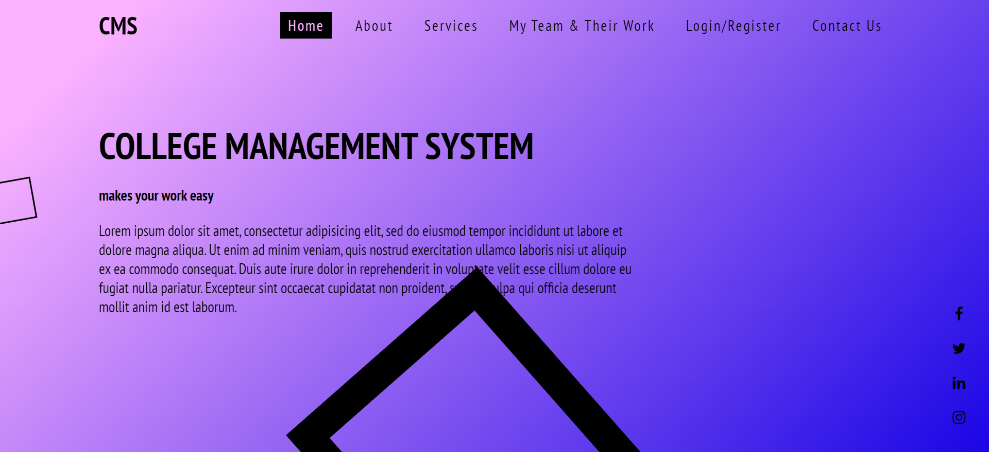
Main Page
Main page Screenshot
College
Management system.,

Slide 7
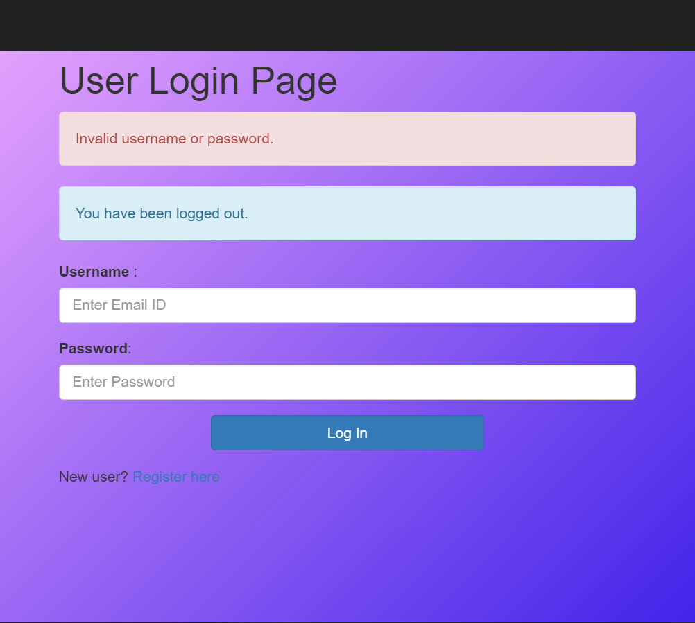
Login & Registration module
The login and registration modules are more comfortable and colourful, the login and registration process contains
Spring boot and thymleaf.
The required dependencies to do the login/registration module are:
1.Spring web
2.Spring data JPA
3.Spring Security
4.MySQL Driver
5.Thymleaf
6.Spring Boot DevTools

Slide 8
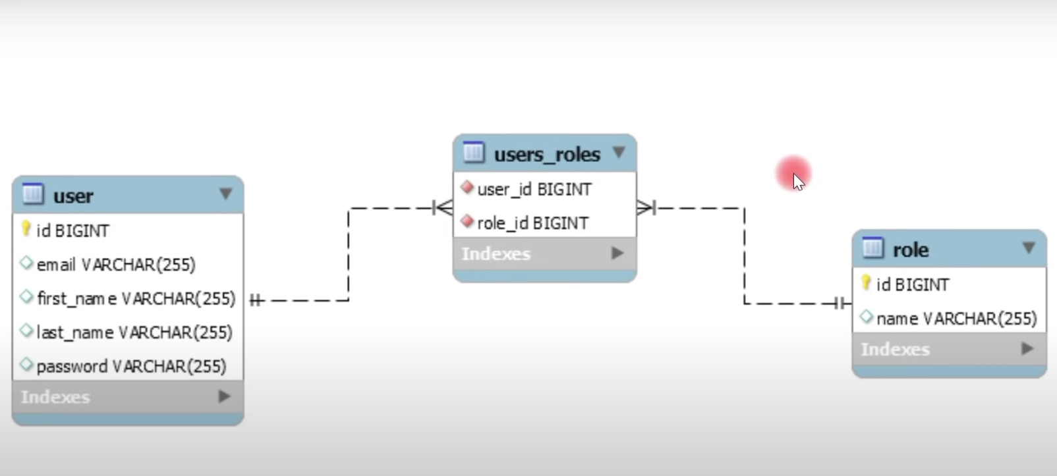
Login
& Registration module
Detailed info
the Hibernate framework helps us in creating the tables:
The entity tables are created and mapped with JPA many to many annotation to interlink with admin module.

Slide 9
Login/Registration architecture
API Layer
API Layer
Business Layer
Dao Layer
Request
Req
User
Registration
Controller
Browser
(Thymleaf)
Res
User
Service
User
Repository
MySQL
Data Base
Response
Front end
Back end
Database

Slide 10
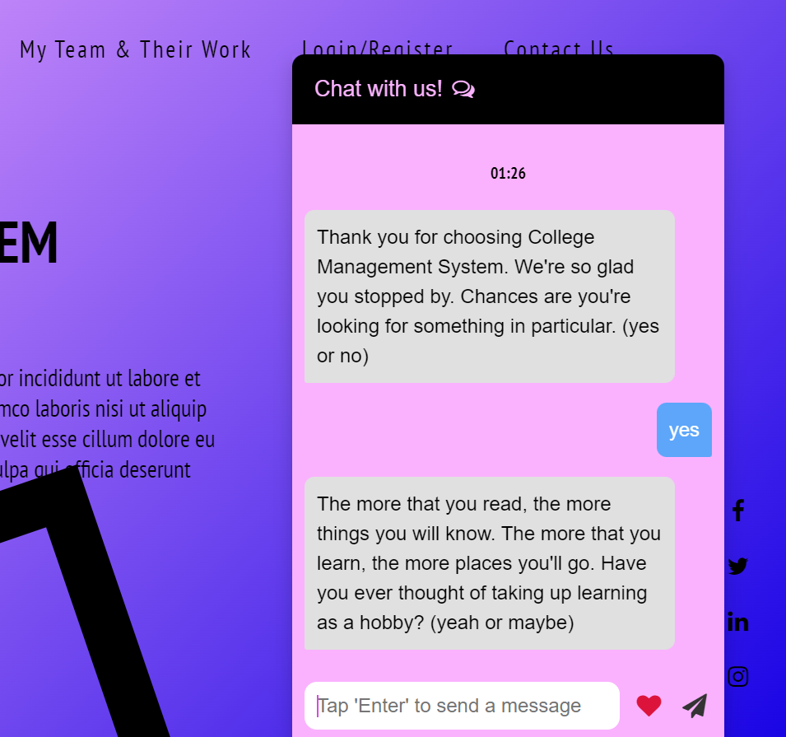
Chatbot Module
The Chatbot is integrated with Main Page module
description
The chatbot is working with pre defined inputs and outputs with the help of java script if-else condition i.e. based on given input the if else condition works
The CSS is used in the style tags within the mainpage.in CSS We used animation delays Font colours, moving objects, layer, and specific timing delays to pre plan the events of every moving objects and chatbot on the main page

Slide 11
Project Overview
Project Architecture
Staff
Admin
Student
Login
Dashboard
Library management
checkout
Academics
Facility

Slide 12
Tech architecture
Spring-core, MVC, data JPA
security
HTML
CSS,thymleaf
JavaScript
Spring Boot
Hibernate
Spring boot
Object persistence
Mapping with POJO
Browser
Frontend
Backend
Hibernate

Slide 13
Dataflow diagram
API Layer
API Layer
Business Layer
Dao Layer
Request
Req
Browser
Res
CONTROLLER
SERVICES
REPOSITORIES
Data
Base
Response

Slide 14
Challenging issues
Mapping issues
Compilation issues
Mapping issues are caused by incorrect data provided
Database issues
Mainly the compilation issues were created by syntax errors
When the duplicate information is sent while there is unique constraint.
Solution
Solution
Solution
White label page can be solved by providing proper annotation and required data to the process
To over come the compilation issues we have to check the code thoroughly, check for logic database link and syntax errors . Understand the error and fix it
The database issues can be solved by correct mapping and providing correct information, sometimes duplicate information gives errors so providing unique when required is important.

Slide 15
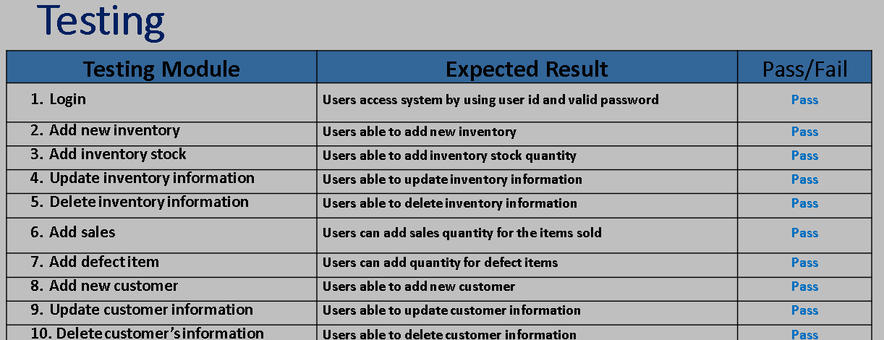
Testing
Testing result for login/Registration : Pass
Testing tools used: Junit
College management system

Slide 16
Features About the module
Colorful & safe for Eyes
Selected the colors which have good effect on eyes and mind, less eyestrain and the color combinations keep mind always active.
functional
All options on the main page are functional and working good.
Features of
Comfortable & smooth working
My
Modules
the moving objects on the screen to reduce boredom and keeps you active, smooth functionality , doesn’t look like static pages.
Safe & secure
The user credentials are safe because the password is encoded and then stored in the database.
Simple Login and Registration
Simple login and registration process if any help required the chatbot will help you through

Slide 17
Future Enhancement
We are not stopping here we want to improve further more.
There are lot more advancements in plan to be done in future and they will be definitely done with my teammates, every new advancement which we provide in future will make this page more and more attractive.
Online payment is also not applicable in many colleges the online payment is to be added
Demo & Paid versions
Similar to Online course enrollment Scheduling also should be done
Online enrollment of courses are new to nowadays colleges still now but we need to advance
Digital Payment
Online Scheduling
With voice-bot we will be one click away to the new kind of conversation.
Online Course Enrolment
College Management System
Voice Bot

Slide 18
Quality improvement task
1. J-Unit Testing
2. DevOps tools approach : Maven,Github
MySQL.
3. UI approach : Chatbot

Slide 19
THANK YOU
Your’s
Poojith sai Geesala
(En.no:-EBEON0322579270)
Guided By: Varadarajan A

